Slide 2
Barrett's esophagus
By:
Mustafa .A. Ali kassem.
Resident doctor in tropical medicine and hepatology department.

Slide 3
Definition :
It is the replacement of the normal squamous epithelium of the distal esophagus with specialized intestinal metaplasia(SIM).
It is thought to be caused by chronic GERD, which leads to esophagitis and subsequent metaplasia of the esophageal lining.

Slide 4
It is named after Norman Barrett ,a thorathic surgeon who described a case of esophageal ulcer surrounded by columnar mucosa found at autopsy.

Slide 5
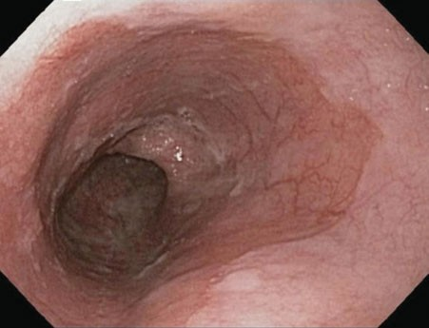

Slide 6
Epidemiology:
The over all incidence →1.6-1.7%.
In patients with GERD →5-10% specially with sever GERD.
In patients with peptic stricture of the esophagus→30%

Slide 7
Sex:
male:female→3:1
Age:
usually middle age.
Race :
- common in Caucasians.
- uncommon in blacks and Asians.
Alcohol and smoking increase the risk of developing Barrett esophagus.

Slide 8
Pathogenesis:
In patients with GERD both gastric acid and bile salts play role in development of Barrett esophagus.
Esophageal PH monitoring studies have shown that :
1.patients with BE have more acid exposure than healthy controls.
2.it results from long duration of exposure to acid(>5min),rather than from greater number of reflux episodes.

Slide 9
Bile salts:
The role of the refluxed bile salts is still debated , increased levels of refluxed bile acid have been found in patients with BE.
Acid and bile have been shown to trigger a class of homeobox genes, which regulate the cellular differentiation.

Slide 10
H.Pylori infection:
There is no clear association between H.pylori and GERD and BE , and the organism doesn’t infect the esophagus.
In fact H.pyloi infection may protect against GERD and BE.

Slide 11
Diagnosis:
It has no symptoms different from that of GERD.
Also, it can not be detected radiologically.
So , the gold standard method for diagnosis of BE is upper endoscopy and biopsy from the distal esophagus.

Slide 12
Endoscopic findings:
In normal persons, the squamocolumnar junction coincides with the GEj. It is the transition from the pale mucosa of the esophagus to the salmon-colored gastric mucosa.
Endoscopic ally, the GEJ is defined as the top of the gastric fold.
If the squamocolumnar j. is above the GEJ ,a columnar lined esoph. is found and biopsies should be taken.

Slide 13
Early studies defined BE as the presence of 3cm of columnar lined distal esoph.
Recent studies defined the presence of less than 3cm as short segment Barrett esoph.
The longer the segment of BE , the higher the risk for developing of adenocarcinoma.

Slide 15
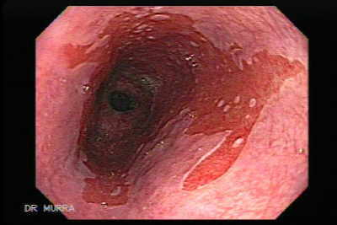

Slide 16
Biopsies:
Biopsies are classified as:
1.Non dysplastic.(negative for dysplasia).
2.Indifinite for dysplasia.
3.low-grade dysplasia.
4.High –grade dysplasia.

Slide 17
Diagnosis of dysplasia should be made with caution as:
Active inflammation due to GERD may cause nuclear changes that mimic low grade and high grade dysplasia.
If biopsies are taken from an area adjacent to an ulcer with numerous neutrophils infiltrating the epithelium , diagnosis of dysplasia may be difficult and diagnosis of indefinite dysplasia is assigned.

Slide 18
Screening:
The role of upper endoscopy screening for BE is still unclear.
The American College of gastroenterology guidelines recommended screening for patients with chronic GERD symptoms who are over 50years.
N.B: a significant proportion of pt. with esophageal adenocarcinoma report no symptoms of GERD.

Slide 19
Survillence:
Definition:
It means performance of serial at regular intervals for patients diagnosed to have BE, aiming for early detection of dysplasia and early cancer at curable stages.
Value:
The overall risk for cancer in BE is 0.5%.

Slide 20
the cost-effectiveness of surveillance in Barrett esophagus is debated.
Retrospective data have shown that
cancers detected during Barrett esophagus surveillance are more likely to be found at an early stage and are associated with better survival compared with those not detected during surveillance

Slide 21
A few studies have demonstrated no difference in overall survival between patients with Barrett esophagus and the general population,,,,,
calling into question the utility of Barrett esophagus endoscopic surveillance

Slide 22
Currently , upper endoscopy with four-quadrant “jumbo” biopsies at 2-cm intervals remains the best method for obtaining surveillance biopsies.
the surveillance interval of upper endoscopy is determined by the degree of dysplasia found in a Barrett esoph

Slide 23
The following table shows summery of recommendations for surveillance endoscopies in Barrett esophagus:

Slide 24
 | ASGE | ACG | AGA
screening | Selected persons, no further screening if BE not found on initial EGD | Controversial, highest yield is in pt. with chronic GERD and >50y | Screening of white male>50y.with chronic GERD may be cost-effective
No dysplasia | Repeat at 1y then every 3y | Repeat EGD, then every 3y | Repeat at 1y, then every 5y
Low-grade dysplasia | Yearly EGD | Yearly EGD | If two pathologists agree dysplasia present then yearly ;if not then every 2y
High grade dysplasia | Confirm pathology; repeat EGD to exclude cancer, consider ablation ,surgery, or surveillance every 3mon. | Confirm pathology; repeat EGD to exclude cancer, if mucosal irregularities—EMR ; consider ablation or surgery | Confirm pathology; repeat EGD to exclude cancer, consider pt., focality of dysplasia; consider intensive surveillance, ablation or surgery

Slide 25
ASGE→ American Society of GI Endoscopy.
ACG→ American Collage of Gastroenterology.
AGA→ American Gastroenterology Association
EMR→ Endoscopic Mucosal resection.

Slide 26
Risk factors for development of adenocarcinoma from BE:
Clinical factors
Endoscopic factors
Male gender
Older age
Tobacco smoking
Heavy alcohol use
High body mass index
Diet low in fruits & veg.
Drugs relaxing LOS
Long seg. Of BE.
Mucosal abnormalities(ulcers, nodularities ,stricture)
Large hiatus hernia.

Slide 27
Histologic factors
biomarkers
High –grade dysplasia
Aneuploidy.
P53 loss of heterozygosity.

Slide 28
Treatment:
A. Non dysplastic BE:
∙PPI→↓incidence of dysplasia especially with prolonged use.
→every pt. diagnosed as BE should be treated with PPI wheather symptomatic or not.
∙anti-secretory drugs → despite long term use there is no regression of long segment BE, regression is described with ultra sort and short segment BE.

Slide 29
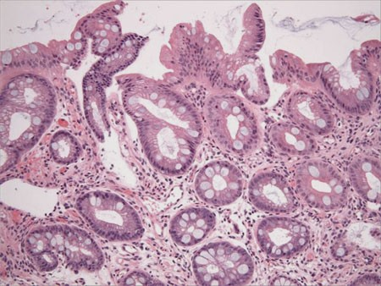

Slide 30
B . indefinite grade dysplasia:
It means nuclear enlargement, prominence of the nucleoli, crowding hyperchromatism noticed in the lower portion of the glands, whereas the upper part of glands and surface epithelium show less or no abnormalities.
If diagnosed → aggressive anti-secretory ttt and repeat surveillance biopsy in 3 months.

Slide 31
C . Low grade dysplasia:
Characterized by mucosal cells containing nuclei that are larger, hyper chromatic with irregular outlines , and basally located in the cells with minimal or no stratification.
Several studies demonstrated that there is no significant increase in the malignant potential of low grade dysplasia than that of non-dysplastic BE.
Also ,some cases showed regression to non dysplastic BE on subsequent biopsies

Slide 32
More recent data suggest the extent of dysplastic crypts to be more significant predicator of esophageal carcinoma.
If diagnosed→ a repeat EGD with surveillance biopsies should be performed within 3-6m and then annually as long as low grade dysplasia persist.
Shorter intervals may be considered if large number of dysplastic crypts is found.

Slide 33
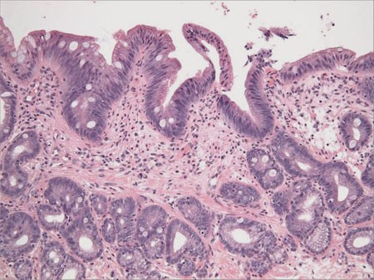

Slide 34
D . high grade dysplasia:
Distortion of the glandular architecture.
The glands are composed of branching and lateral budding crypts.
The most important feature is loss of nuclear polarity , and absence of a consistent relationship of nuclei to each other.
Should be diagnosed by two GIT expert pathologists.

Slide 35
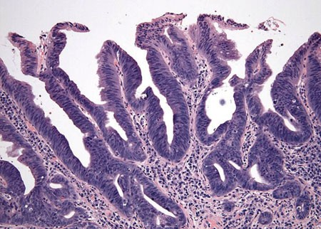

Slide 36
Esophagectomy , mucosal ablation or endoscopic mucosal resection :
this depend on several factors such as operative risk of the patient , extent of high grade dysplasia, its focality.
If dysplasia is focal (five or fewer crypts) , or in the form of nodule , endoscopic mucosal resection (EMR) should be considered.

Slide 37
EMR:
resection of the mucosal layer of the esoph. after separating it from the muscular layer with sub mucosal inj. Of saline or band ligation.
Its main risks include bleeding and perforation.
It should be preceded by endo. u/s to confirm the extent of the lesion.
Its frequently associated with endo. Ablation technique as radiofrequency ablation,…

Slide 38
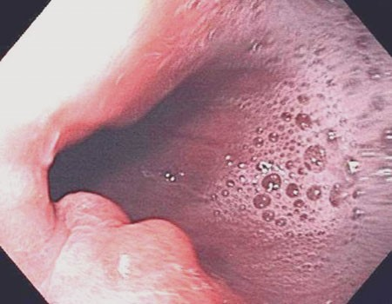
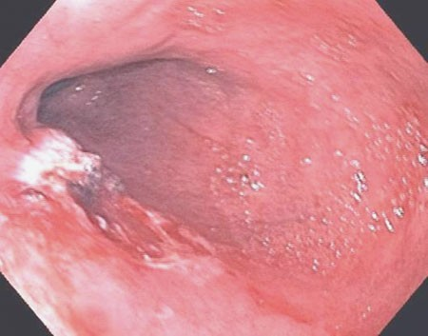

Slide 39
Photodynamic therapy:
The patient is given an I.V photo sensitizer which is taken by the dysplastic cells. After a time delay, a laser light of certain wave length is used to illuminate the tissue and activate the photo sensitizer which reacts with oxygen and mediate cell damage.
Used for patient with extensive , diffuse high grade dysplasia or intra mucosal carcinoma and not surgically candidate

Slide 40
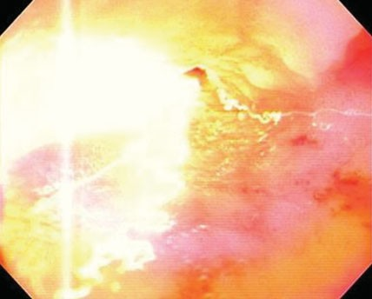
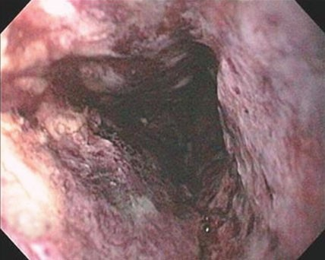

Slide 41
Risks of photo dynamic ablation include:
Stricture, atrial fibrillation, pleural effusion.
The over all survival and mortality rates are the same as of those of esophagectomy.
Other endoscopic ablative techniques include radiofrequency ablation, focal thermal ablation, and cryo ablation methods.

Slide 42
Esophagectomy:
is a highly invasive maneuver .
It is associated with 3-10%mortality rate and up to 45%morbidity.

Slide 43
Course and prognosis:
The course and prognosis of the majority of patients with BE are benign , as the disease can be managed effectively by appropriate surveillance, acid suppression therapy, and patients reassurance.

Slide 44
Thank you

